Slide 1
Time Series Analysis of Hotel Booking Demand and Pricing Trends
Yifeng Cao

Slide 2

Data description and summary
Average Daily Rate (adr): is defined by dividing the sum of all lodging transactions by the total number of staying nights, which is usually used to measure average daily revenue from hotel rooms
Other unused data variables:
lead time, arrival date year, arrival date month, arrival date week number, arrival date day of month, stays in weekend nights, stays in week nights, children, babies, meal, country, market segment, distribution channel, is repeated guest, previous cancellations, previous bookings not canceled, reserved room type, assigned room type, booking changes, deposit type, agent, company, days in waiting list, customer type, required car parking spaces, total of special requests, reservation status
reservation status date: Date at which the last status was set.
hotel: Type of hotel, there are two types: "City Hotel" and "Resort Hotel".
Data source: Hotel Booking Demand Datasets from Kaggle

Slide 3
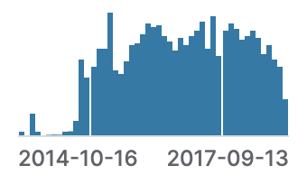
Descriptive statistics
Average daily rate (adr): The average daily rate is about 102, but the standard deviation is large, which indicates that the rate fluctuates.
Multiple adr values for the same date
Discontinuous time

Slide 4

Preparation for the dataset
For the part with excessive missing data - Filtering Data, Retaining Only Records from the Period of July 1, 2015 to September 7, 2017
For the part with fewer missing data –
If any, adding Dates and Imputing Missing Values in the 'adr' Column with the Column's Median (accounting for high SD)
Discontinuous time
Group data by reservation status date and hotel type, and calculate the daily average price.
Multiple adr values for the same date

Slide 5
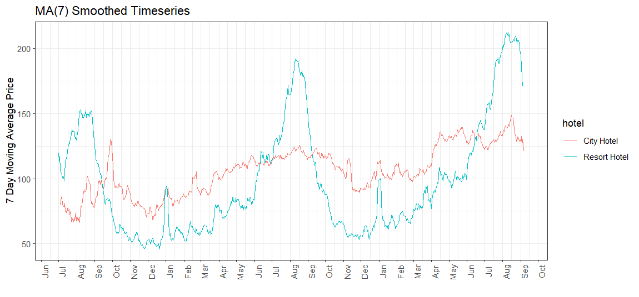
Resort hotels show more seasonal adr variation
Notes:
Autocorrelation not able to test because of not enough data

Slide 6
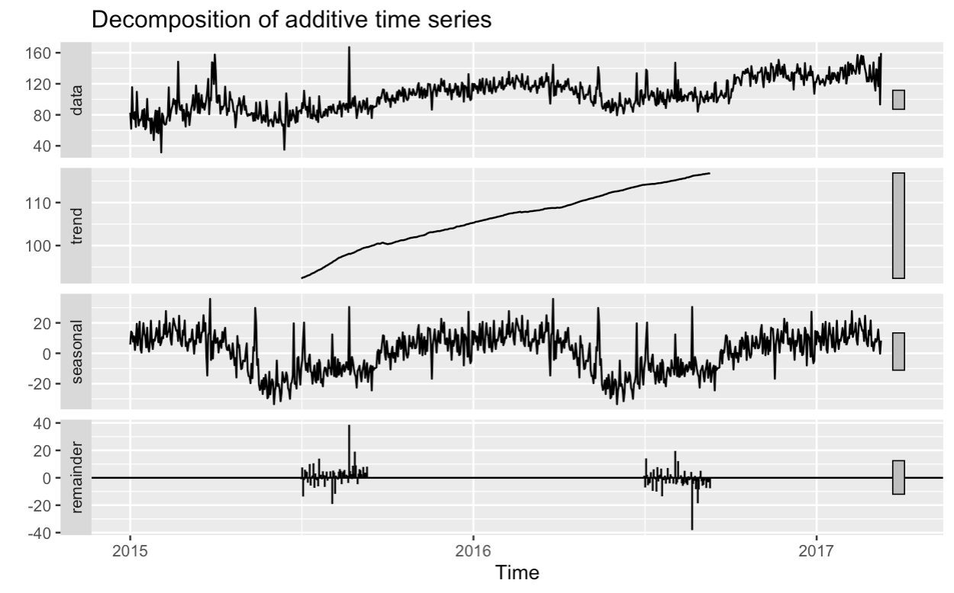
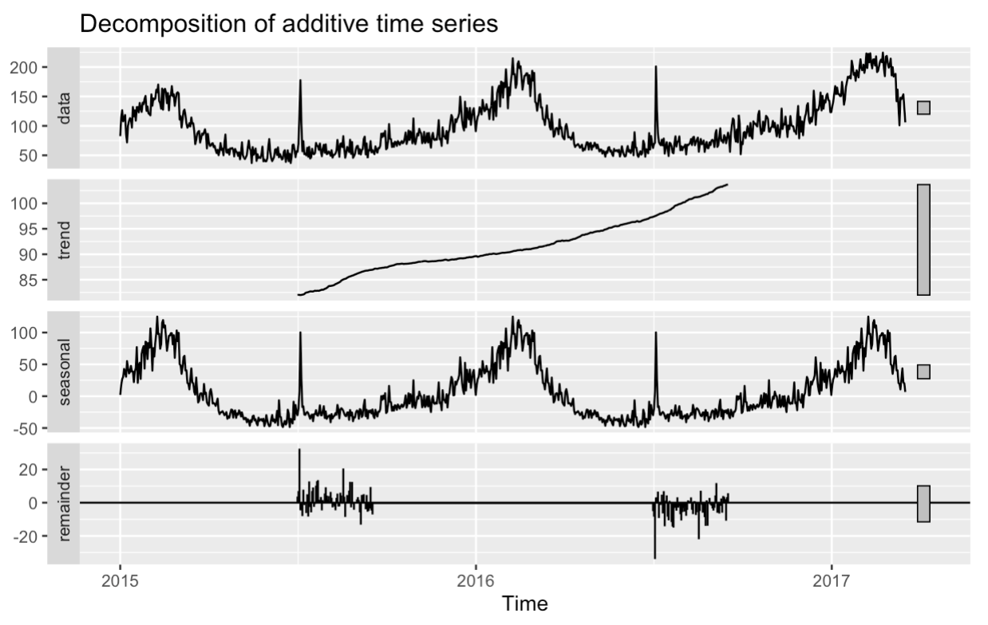
Both resort and city hotels have increasing trends
City Hotels
Resort Hotels

Slide 7
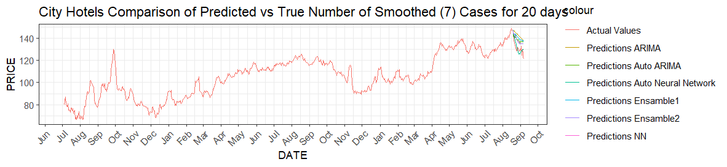
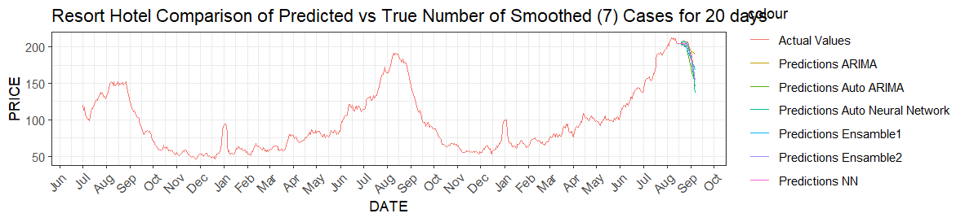
Neural Network performs best overall
 | Neural Network | Auto Neural Network | ARIMA | Auto ARIMA | Ensemble 1 | Ensemble 2
City | 8.1815 | 4.1812 | 11.859 | 9.1055 | 10.389 | 7.8051
Resort | 4.4352 | 5.3794 | 13.413 | 8.3786 | 7.8467 | 5.8005

Slide 8

Conclusion
Resort hotels show more seasonal adr variation, and they have greater SD compared to City hotels
Both Resort and City hotels have increasing trends in the adr
Neural Network performs best among different models

Slide 9
Thank you!

